Slide 1

Tividale Hall Primary School
KS2 SATS Guidance for Parents -
SPRING 2026

Slide 2
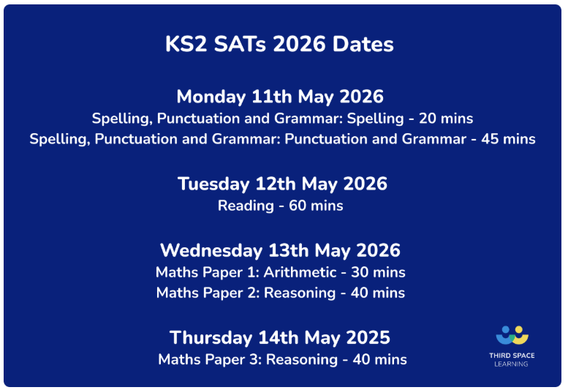
WHEN ARE THE TESTS?
All KS2 SATs will be held in the week beginning 11th May 2026.
The tests must be taken on the scheduled days.

Slide 3
KS2 Assessment in 2026
Statutory assessment
KS2 national curriculum tests with outcomes in the form of scaled scores.
Teacher assessment at KS2 for writing, using the framework for teacher assessment.
On-going classroom assessment
Determined by schools in line with their curriculum.

Slide 4
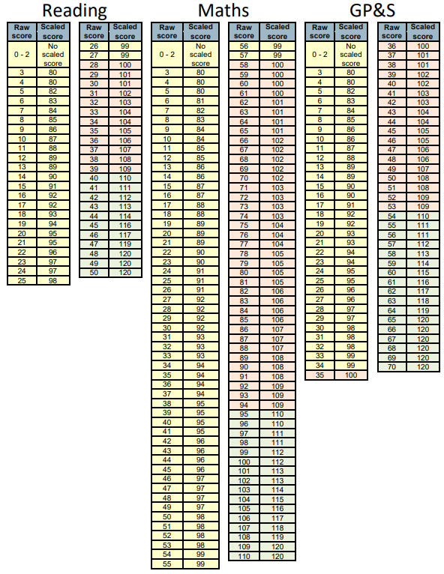
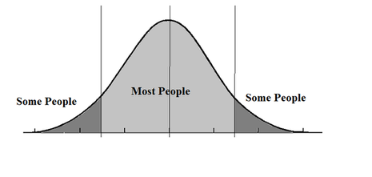
2024 Scaled Scores
2025
Scaled Scores
110
GDS
100
EXS

Slide 5
GPS
(Spelling, Punctuation and Grammar)
Monday 11th May | Paper 1: questions (50 marks) 45 minutes
 | Paper 2: spelling (20 marks)
Total marks: 70

Slide 6
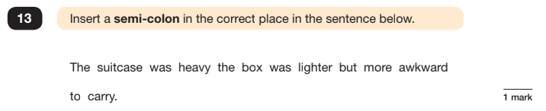
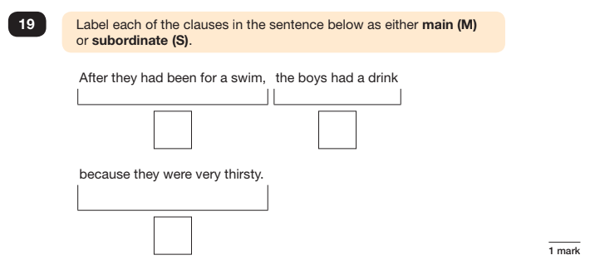

Slide 7
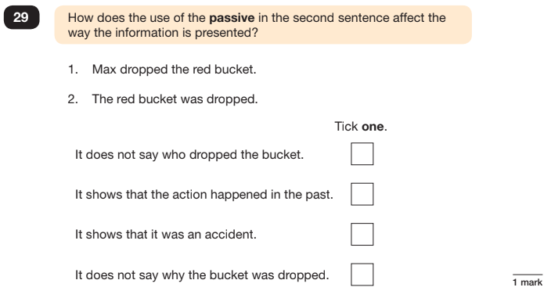

Slide 8
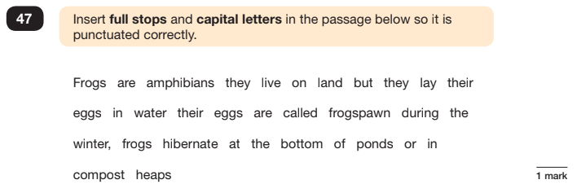
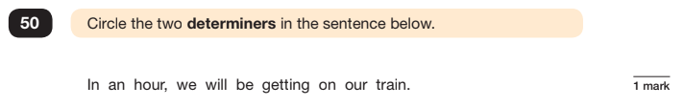

Slide 9
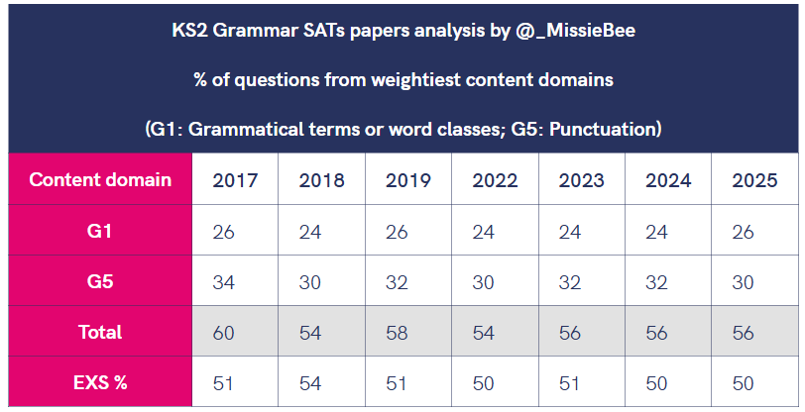
The majority of questions in the grammar test have consistently been based on punctuation (G5) and grammatical terms and word classes (G1). So much so that, in every year since 2017, children could have passed the 2023 Grammar paper by answering questions related solely to these two content domains.

Slide 10
Reading
Tuesday 12th May | English reading paper (60 minutes) 2025 ARE: 28/50 GDS: 40/50
Total marks: 50
2025 Breakdown of the key domains
Words in context – 6/50 marks available – 12%
Retrieval – 15/50 marks available – 30%
Inference – 24/50 marks available – 48%
The remaining 10% of marks are awarded to questions that focus on prediction, summarising and sequencing.

Slide 11
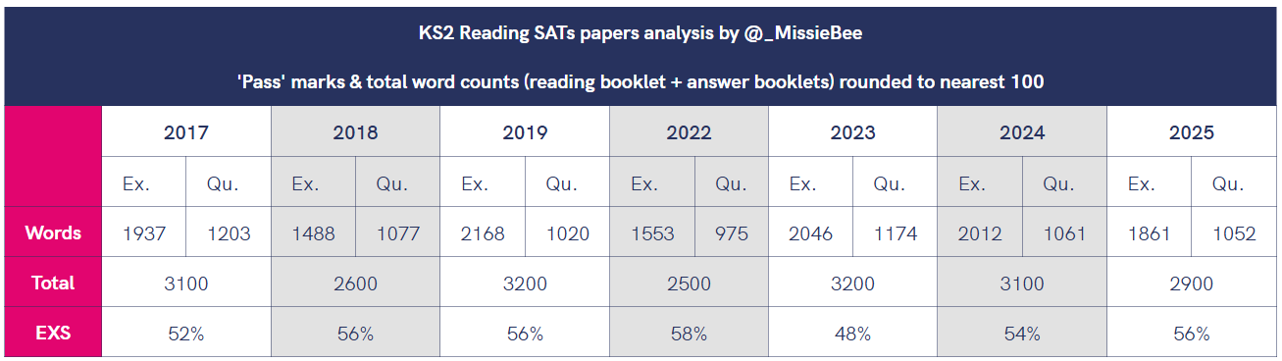
As you can see, the word count in 2019 was considerably more than any other years, this is why children are being asked to read as much as they can.

Slide 12
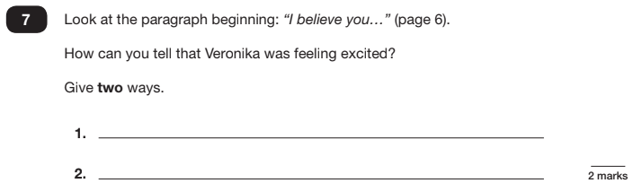
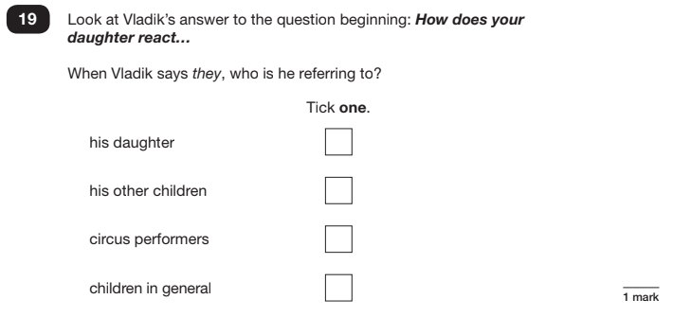
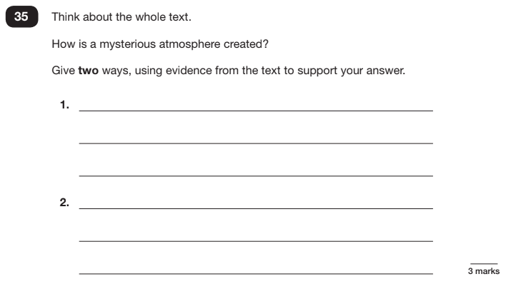
Reading Inference examples

Slide 13
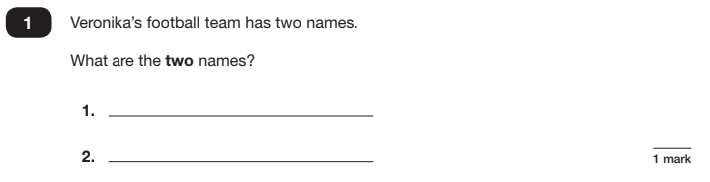
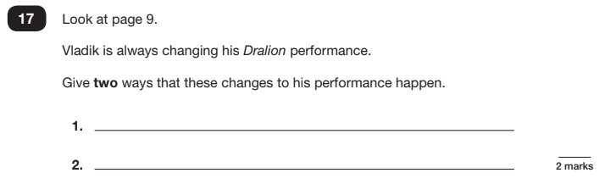
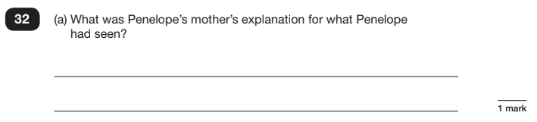
Reading Retrieval examples

Slide 14
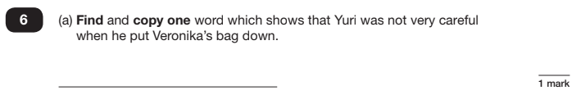
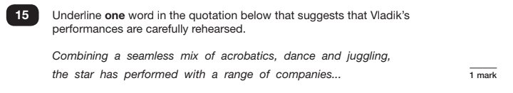
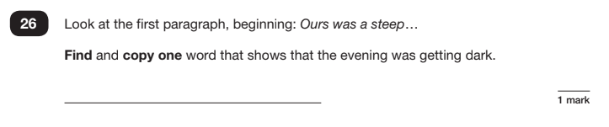
Reading Words in Context examples

Slide 15
How to help your child with Reading
Listen to your child read regularly. Ensure that they are achieving their reading targets given to them by the class teacher.
Focus on developing an enjoyment and love of reading .
Read a little at a time but often, rather than rarely but for long periods of time!
Talk about the story before, during and afterwards – discuss the plot, the characters, their feelings and actions, how it makes you feel, predict what will happen. Challenge their ideas and get them to support their view with evidence from the text.
Identify words in context and other challenging vocabulary but encourage them to work out the meaning.
All reading is valuable – it doesn’t have to be just stories. Reading can involve anything from fiction and non-fiction, poetry, newspapers, magazines, football programmes, TV guides.
Ensure your children are reading books within their Accelerated Reader level.

Slide 16
Maths
Wednesday 13th May | Paper 1: Arithmetic (out of 40 marks) 30 minutes
 | Paper 2: Reasoning (out of 35 marks) 40 minutes
Thursday 14th May | Paper 3: Reasoning (out of 35 marks) 40 minutes
 | 2025 ARE: 58 marks (+4 from 2024) GDS: 95 marks (+1 from 2024)
Total marks: 110

Slide 17
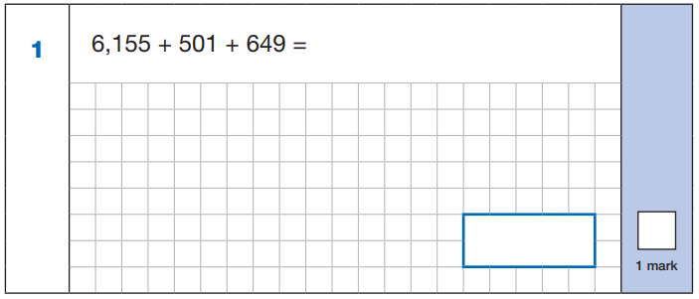
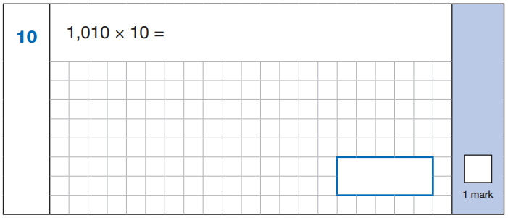
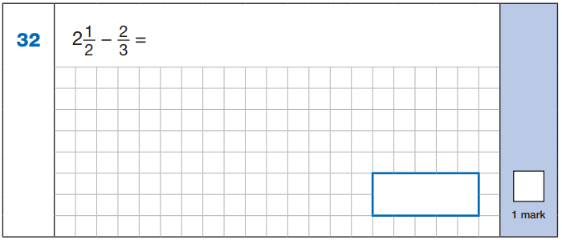

Slide 18
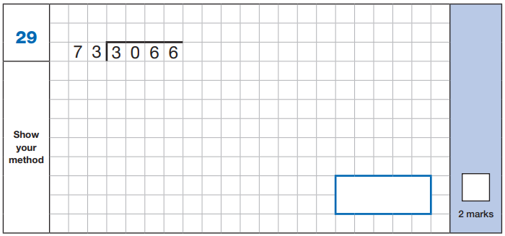
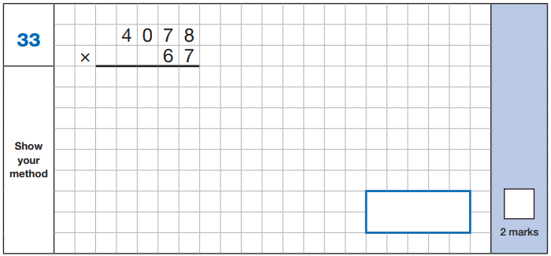

Slide 19
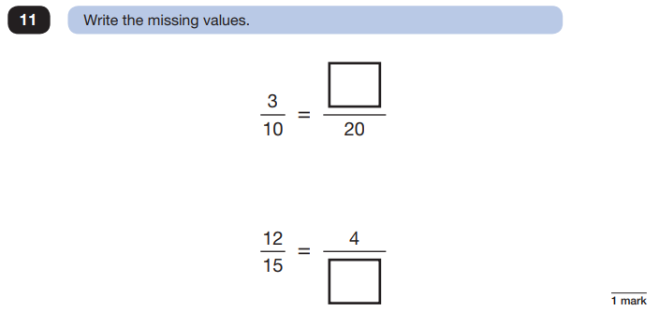
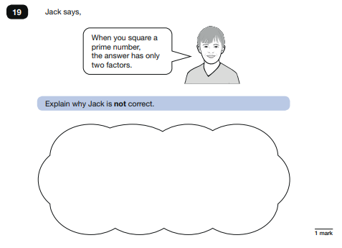

Slide 20
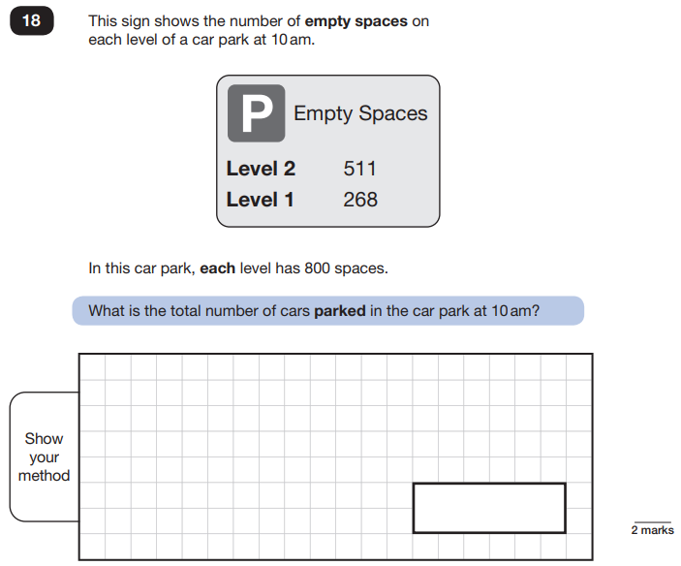

Slide 21
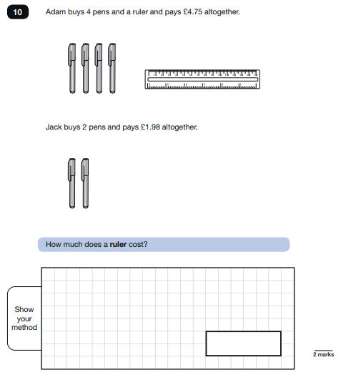

Slide 22
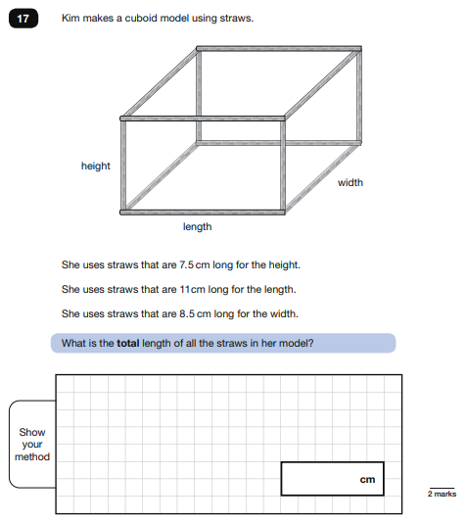

Slide 23
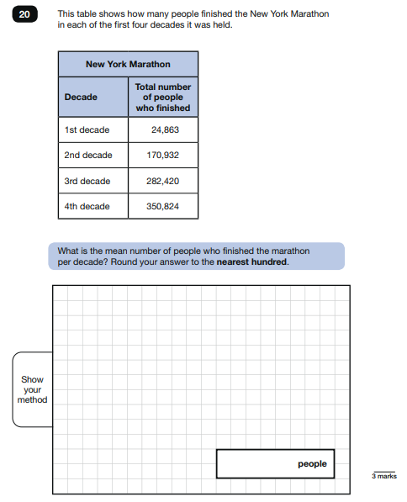

Slide 24
Common errors
Missing out the correct unit of measurement in the answer
General presentation – final answer not being clear
Numbers not clearly formed e.g. ‘0’ looking like a ‘6’
Decimal points – missing them out or making them look like a comma
2 step problems – make sure children follow the whole question through
Recording the monetary values incorrectly e.g. must be £8.90 not £8.9

Slide 25
How to help your child with Maths
Play times table games
Play mental maths games including counting in different amounts, forwards and backwards.
Encourage opportunities for telling the time.
Encourage opportunities for counting coins and money; finding amounts or calculating change when shopping.
Look for examples of 2D and 3D shapes around the home.
Identify, weigh or measure quantities and amounts in the kitchen or in recipes.
Play games involving numbers or logic, such as dominoes, card games or darts.

Slide 26
Writing
June | Collection of children’s writing from a range of genres.
Children will not be tested on their writing during SATs Week.
After being ‘Teacher Assessed’, children’s writing will be moderated in school and could be moderated by the local authority.
Final judgements will be reported to parents/carers along with the result of all other assessments in July and passed onto their secondary school.

Slide 27
Results
Tests are not marked in school; they are sent away, marked externally and not returned to school
You will receive your child’s results with their annual written report
This will be in the form of a scaled score:
  Working towards the expected level (Scaled score of below 100)
  Working at the expected level (Scaled score of 100-109)
  Working at greater depth within the expected level. (Scaled score of 110+)

Slide 28
Illness on the day of a test
Please try and ensure your child is in school throughout that week
If they are ill, they can still take the test up to 5 days after the date on the timetable, providing they do not have contact with other pupils who have already had the test.

Slide 29
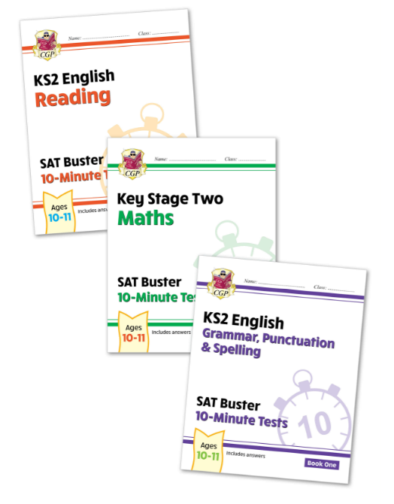
What are we doing to support our Year 6 children?
Booster groups inside and outside of school
In-class interventions
SATs Revision Guides:
these have been purchased for children
to have in school
Times Table Rockstars
Providing breakfast on test days during SATs week
A balanced curriculum

Slide 30
How can we work together to support our Year 6 children?
First and foremost, support and reassure your child that there is nothing to worry about and they should always just try their best. Praise and encourage!
Ensure your child has the best possible attendance at school.
Reading, spelling and arithmetic (e.g. times tables) are essential to practise.
Carry on with normal clubs and all the fun activities they take part in outside of school.
Have normal bedtime routines so they aren’t tired.
Breakfast club will be available free of charge for the whole of Year 6 during SATs week from 8am.

