Slide 1
Welcome
To The
Year 6
IMPACT Workshop

Slide 2

By the end of today’s session:
Success Criteria:
To have an understanding of how Guided Reading is taught within Year 6,
To have worked with your children to practice the key skill domains.

Slide 3
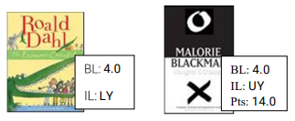
Reading Books
It is a requirement that your child reads for at least 20 minutes each night. The more they read, the more they know, the more their reading will be accelerated.
If your child has books that they want to read at home, but they do not have an accelerated reader sticker, they are still ok to read these.
Accelerated Reader has a database of over 27,000 books so we can check if it is there.

Slide 4
Guided Reading
Guided Reading in Year Six looks the same as it did in Year 5 for the first term of school.
Our lessons run this way:
Monday – Discussing and unpicking the text
Tuesday – Retrieval questions
Wednesday – Vocabulary questions
Thursday – Inference questions
This will change however, as we move closer to the End of Key Stage Two assessments. During this time, they will be exposed to more texts, and mixed comprehension questions.

Slide 5
SATs 2026
Sats week for our Year 6 children will be week commencing 11th May 2026.
Monday – Paper 1: Grammar, Punctuation and Spelling – 45 minutes
Paper 2: Spelling Test
Tuesday – Reading Paper – 60 minutes
Wednesday – Paper 1: Maths Arithmetic – 30 minutes
Paper 2: Maths Reasoning – 40 minutes
Thursday – Paper 3: Maths Reasoning – 40 minutes

Slide 6
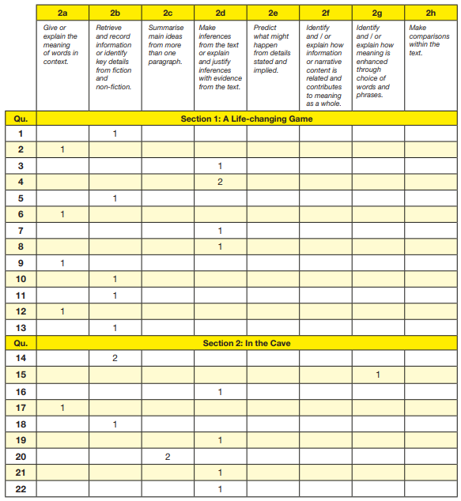
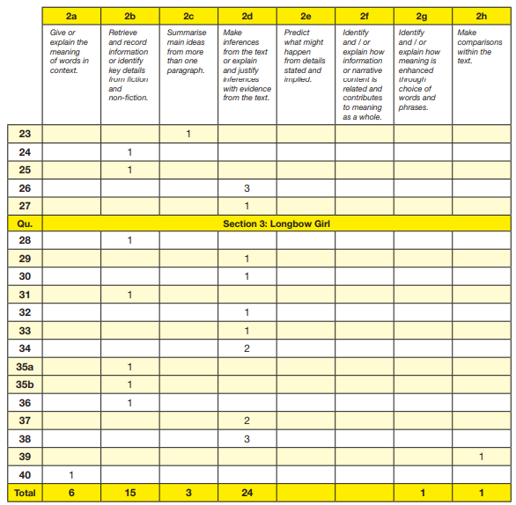
2025 SATs
This is the mark scheme for the 2025 reading SATS paper.

Slide 7
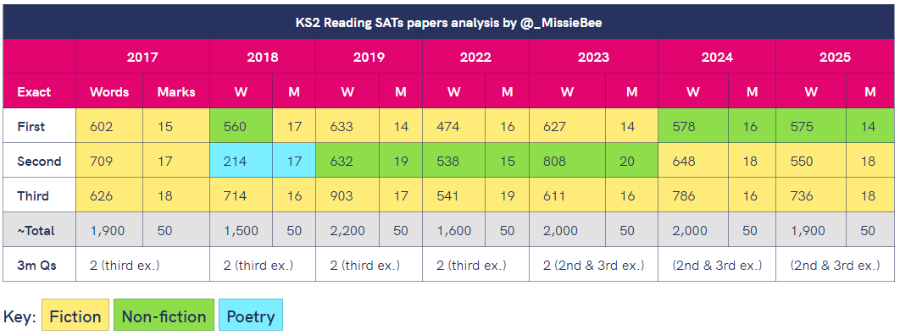
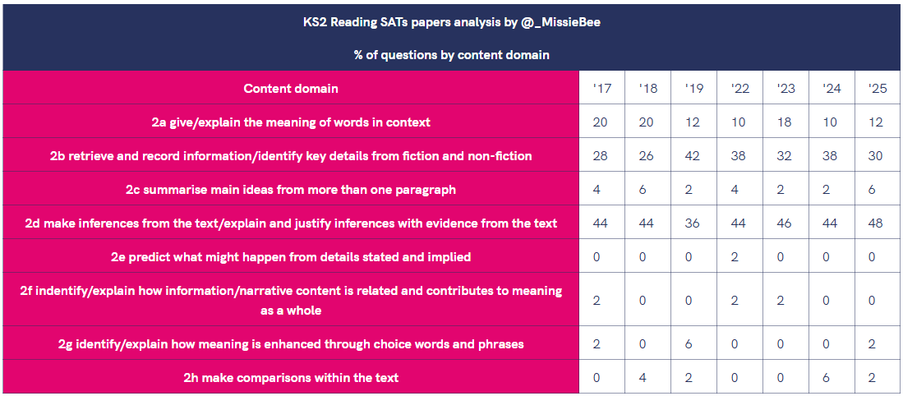
The 2025 SATs were out of 50 marks.
Vocabulary - 6/50 marks
Retrieval - 15/50 marks
Inference – 24/50 marks
This is why our Guided Reading is so heavily focused around these three main domains.
As you can see, the word count in 2019 was the ‘wordiest’ year yet; the year that followed (2022) was less; this year is in-line with the previous two years. This is why children are being asked to read as much as they can.
Retrieval and inference have been the most represented content domains in every SATs paper. The proportion of retrieval questions dropped this year to 30%, whilst inference questions were at the highest they’ve ever been - nearly half the paper!

Slide 8
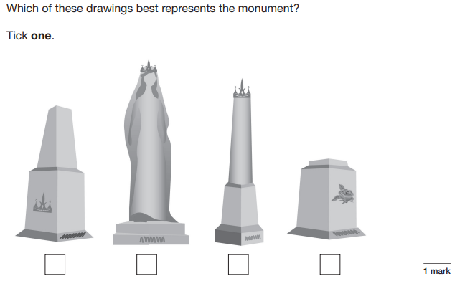
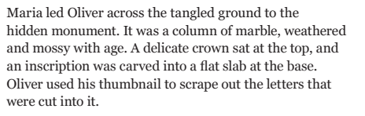
Let’s have a go…Retrieval

Slide 9
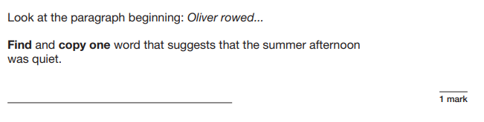
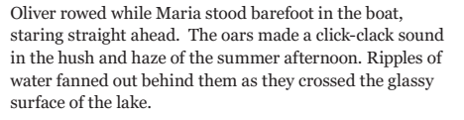
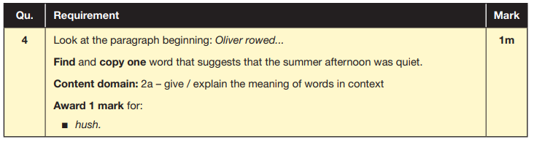
Let’s have a go…Language

Slide 10
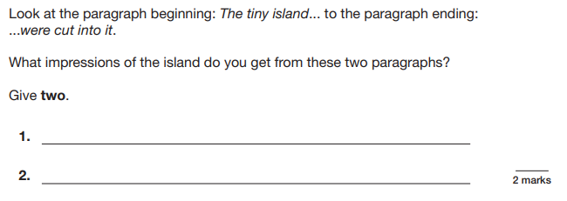
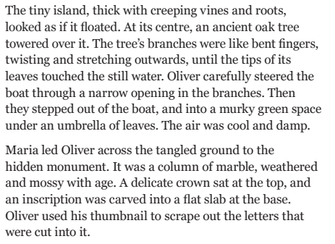
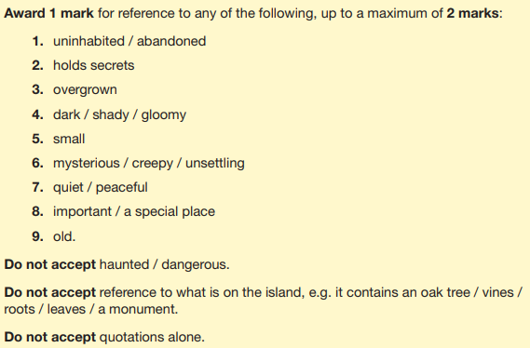
Let’s have a go…Inference

Slide 11
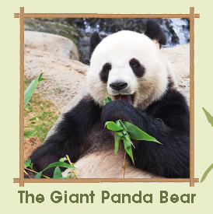
Your Turn…
Read the text ‘The Giant Panda’
Working with your partner, have a go at answering the questions that relate to the text.
Remember to think about what the key words are in the question as this will help you to identify the answers in the text.
Mark schemes are available once you have finished.

