Slide 1


Transition Meeting for Parents of children going into Panthers or Jaguars in Year 6

Slide 2

Class Teachers
Miss Stanley
Mr White
Mr Higgins

Slide 3

Timings
Children are to line up on the bottom playground at the bottom of the ramp.
They will enter school from 08.45 by walking up the ramp, across the bridge and into the top hall.
Children will be dismissed from the top hall at the end of the day at 15.30.
If you would like your child to walk home on their own, they must have written consent.
Children can bring their mobile phones to school, but they must not use them on the school premises. They will be collected at the beginning of the day and handed back at the end.

Slide 4
Bags and Toileting
.
Children’s bags will be kept in the top hall in lockers. They will bring their PE kits in on PE days and take it home each week.
Children can bring in pencil cases at your
discretion, but it is the children’s responsibility
to look after what is in there. It is not an
expectation because all essential equipment will
be provided.
We encourage all children to use the toilets at the
beginning of the day and during break and
lunchtimes; however, we will aways allow children
to go the toilet if they really need to.

Slide 5
Expectations
.
In Year 6, we really encourage all children to start showing a greater level of independence. This includes:
- ensuring that homework is completed each
week,
- reading books and reading records are brought
to school each day and targets are met each week,
- not blaming parents for not getting their things
ready (e.g. forgetting PE kits, water bottles etc.)
We expect our Year 6 pupils to be role models for
the rest of the school.

Slide 6

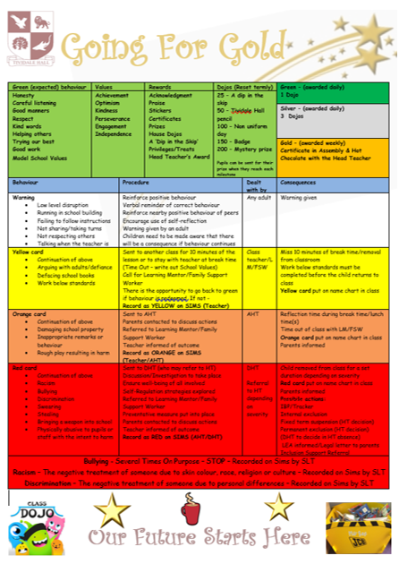

Slide 7
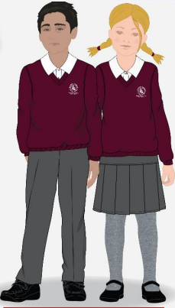
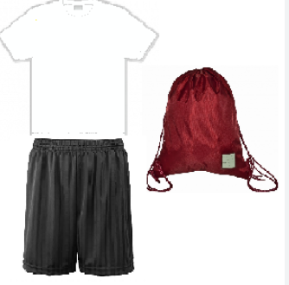


Uniform and PE Kit

Slide 8

The Curriculum
Overviews on the school website Tividale Hall Primary - Our Curriculum
Topics

Slide 9
Themes
Autumn – World War II
Spring – The Maya
Summer – Natural Disasters
Notes:
Head Boy/Girl/House Captains

Slide 10
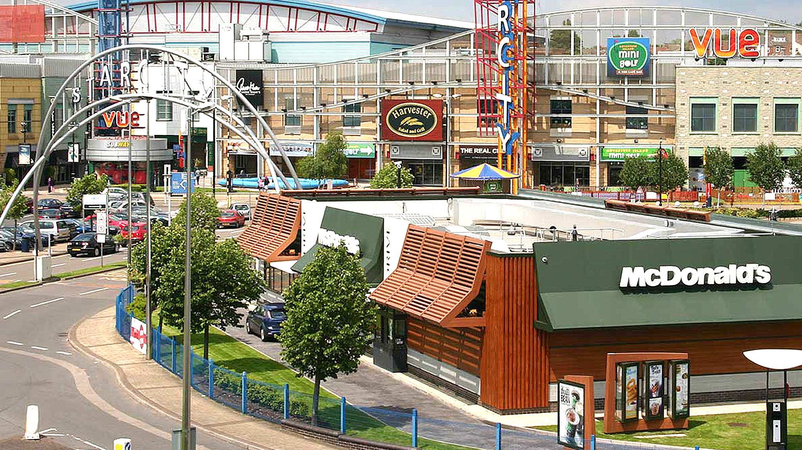
Trips and Experiences
Y6 Reward Day at Star City
A residential potentially???

Slide 11


School Nurse Sessions
A drama company that sensitively discusses relationships and how our bodies change as we grow older.
School nurses also come in to do the children’s height and weight in the Spring Term.
The RSE Curriculum

Slide 12
Homework
This will be set each Friday, printed out and stuck in their books,
Spellings are set each Monday and tested on each Friday,
TTRockstars,
Reading Targets.

Slide 13

Statutory Assessments
SATS Week: Monday 11th – 14th May 2026
- quality first teaching from Mr White, Miss Stanley and Mr Higgins
boosters/interventions/
precision teaching
- revision books
January 2026: Detailed SATs Meeting

Slide 14
Transition to Secondary School
Apply for secondary school by the end of October 2025.
On your application form, it is important that you put down multiple options as there are no guarantees that you will be offered your first choice.
Make sure you try and attend the Open Days that secondary schools put on - these will most likely be throughout September.
We have Hannah Butler, who is a Sandwell Education Advisor, conducting a parent meeting in school on the 4th September at 09:15 regarding this process.

Slide 15
Transition to Secondary School
This is one of our main aims in Year 6. We will do all we can to ensure that your children are prepared for secondary school.
When school places are confirmed in March, children will then start to make connections with their next schools. This includes transition days, which usually happen at the beginning of July, meetings with some of their teachers and for some additional time spent at their new school.

Slide 16

Communication
Phone calls
at the end of
the day
Parents’
Evening
School
Office
We will not be responding to messages via Seesaw.

Slide 17
Any Questions?

