Slide 1
Resources:
Text
Exercise books
Prediction task/picture
Questions
Post its

Slide 2
Welcome to the Year 5 Reading Workshop

Slide 3
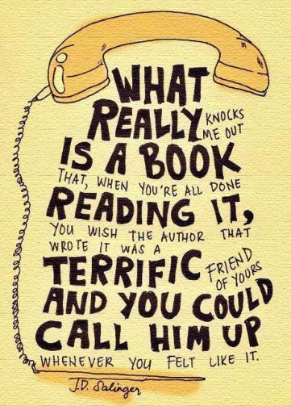


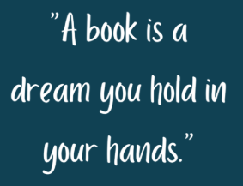

Slide 4
Why is reading important?
Reading improves vocabulary and language skills. Children learn new words as they read. Subconsciously, they absorb information on how to structure sentences and how to use words and other language features effectively in their writing and speaking.

Slide 5
Home reading books
Children complete a ‘Star Reader’ quiz to determine the range of books which are appropriately challenging for them.
Children are encouraged to select their own book according to what appeals to them.
Targets are set each Monday. 2 dojos are given when achieved.
Additional dojos are awarded for evidence of parental comments.
Book quizzes are taken on completion of each book.
70%+ means that a child can move up a level within their range.

Slide 6
Reading records
Now that children are in Year 5, they are expected to keep their reading records up to date by:
Listing the books they have read inside the front cover.
Keeping a record of every time they read including the date, title and number of pages read.
There is a comment box which is intended to be used for adult comments (teachers and parents) along with quiz results (in green) and targets (in red).

Slide 7
Reading for pleasure
https://literacytrust.org.uk/reading-for-pleasure/
Children who regularly read for pleasure have better self-esteem and emotional regulation, with lower levels of emotional and behaviourial challenges such as anxiety and aggression than those who don't. Children who read have higher levels of mental wellbeing and happiness.
Notes:
Mention the library, class reader and sought opportunities to encourage reading for pleasure e.g. Michael Rosen Day (13th November and WBD)

Slide 8
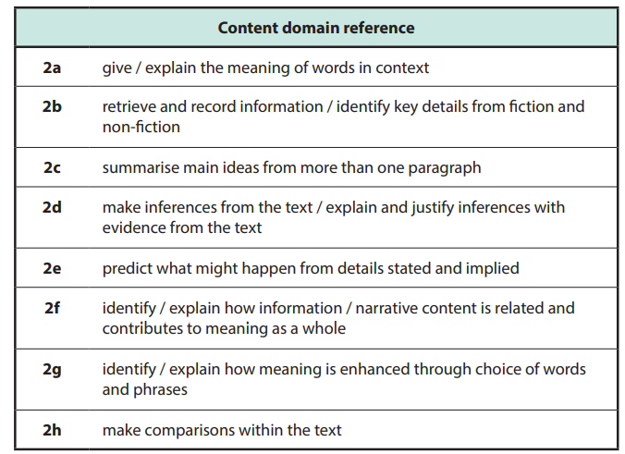
Skills taught during guided sessions
Notes:
Mention preparation for Year 6.

Slide 9
Guided Reading

Slide 10
Thursday 16th October 2025
Reading Workshop

Slide 11
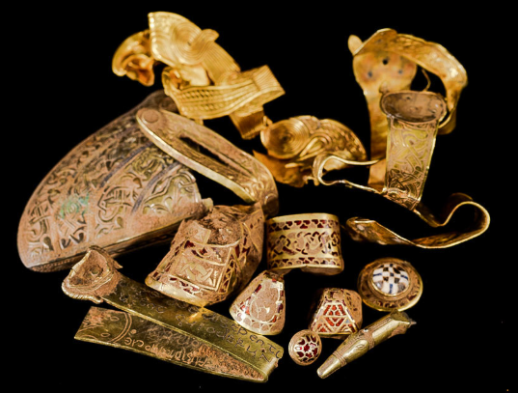
PREDICT
What might our text be about today?

Slide 12
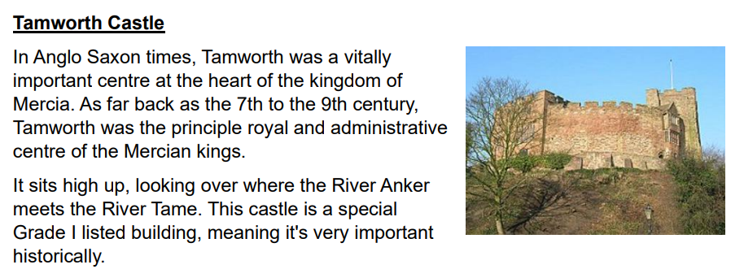
Step 1: Discussion of the text
administrative: being in charge; managing
Which Kingdom was Tamworth part of?
What does it mean to be a Grade 1 listed building?
Notes:
Add annotations

Slide 13
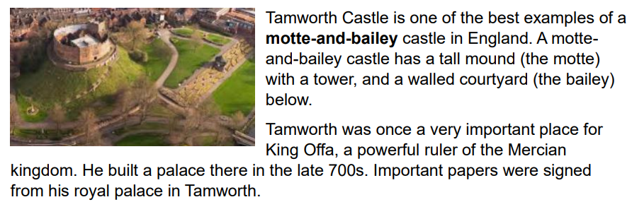
Who was King Offa?

Slide 14
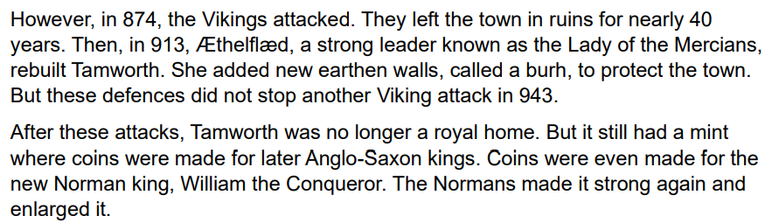
How many Viking attacks were there?
When did they happen?
Find the word meaning ‘to make bigger’.
Why do you think the Normans did this?

Slide 15
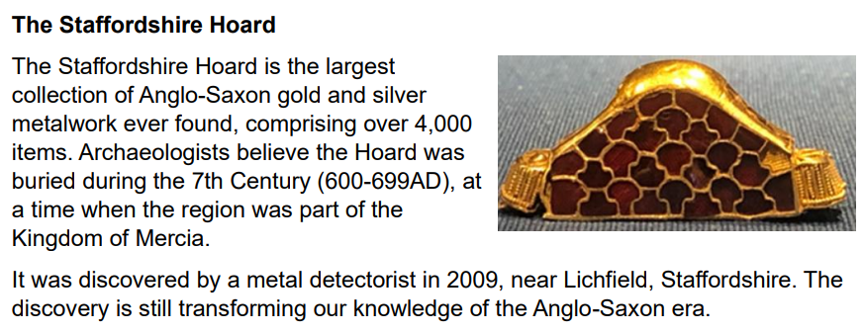
An archaeologist is:
a) Someone who enjoys digging things up.
b) Someone who studies history by digging up artefacts.
c) Someone who studies history by writing books.
Era: a period of time in history

Slide 16

Step 2: Retrieval
L.O:To able to retrieve information from the text.
 | Success Criteria – Have I:
Identified the skill of the question?
Located the information within the text?
Used key information from the text to answer the question?

Slide 17
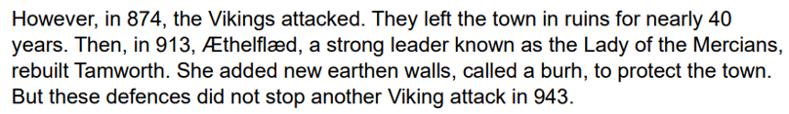
My Turn
Look at the 5th paragraph.
True or false
The Vikings attacked once.

Slide 18
Our Turn
Look at the 5th paragraph.
Who rebuilt Tamworth?

Slide 19
Your Turn
Look at the 5th paragraph.
Was Aethelflaed successful in defending Tamworth?
Explain why.

Slide 20
Step 3: Working out the meaning of words in context.
 | Success Criteria – Have I:
Identified the word in the question I am being asked to define?
Read around the word to understand the context?
Made inferences based on what I already know?

Slide 21
My Turn
Look at the final part of the text.
Find and copy the word closest in meaning to ‘made up of.’

Slide 22
Our Turn
Look at the final part of the text.
Find and copy the word closest in meaning to ‘area.’

Slide 23
Your Turn
Look at the final part of the text.
Find and copy the word closest in meaning to ‘changing.’

Slide 24
Step 4: Inference
LO: To understand how to draw inferences from characters’ thoughts and feelings and justify these with evidence.
 | Success Criteria – Have I:
Identified the key words within the question?
Explored the thoughts and feelings of the author?
Supported my answer with evidence from the text?

Slide 25
My Turn
Look at the final paragraph.
Why is the Staffordshire Hoard so important?
Because….

Slide 26
Our Turn
Look at the final paragraph.
Why can archaeologists only believe that the Hoard was buried during in the 7th Century?

Slide 27
Your Turn
Look at the final paragraph.
Is it possible that we can still learn more about the Anglo Saxon era? Yes No
Because…

Slide 28
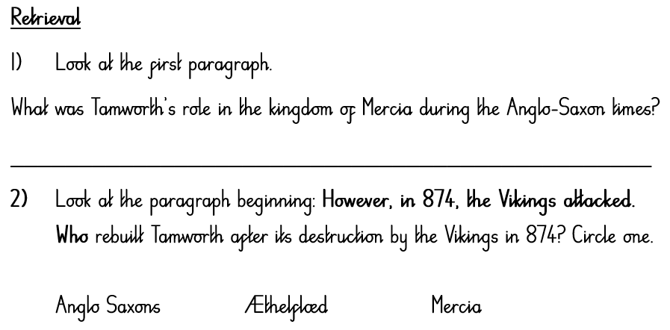
Independent Task

Slide 29
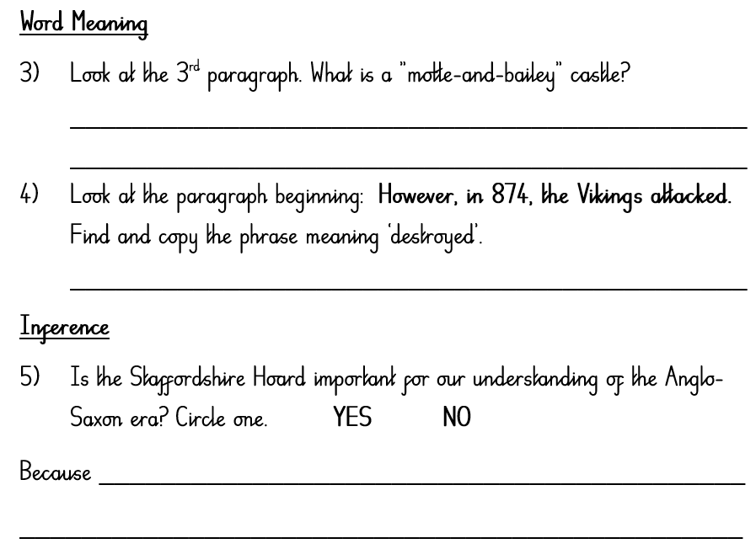
Independent Task

Slide 30
Tomorrow’s trip…

Slide 31
Why are we going?
Saxon Archaeology - The children will meet an archaeologist and learn about archaeological practices and object handling. They will learn the about what Saxons left behind for us to find and therefore understand how they lived. In small groups the children will have the chance to try out their skills as a trainee archaeologist by retrieving and cataloguing finds from sample find boxes.

Slide 32
Why are we going?
Saxon & Viking Soldier - This runs along the same style as the Saxon Soldier workshop but at each stage the children will compare the differences and similarities between Saxons and Vikings. Also they will learn about the differing tactics used by each side and have an opportunity to role play Saxons or Vikings by practicing their battle cries in the shield wall.

Slide 33
Reminders
Please be on time. The coach leaves at 9:15.
We should be back by 3:00.
Bring a packed lunch unless you have ordered one in a disposal bag with your child’s name on.
Do not bring lunchboxes or back packs.
Do not bring any food containing nuts.
Wear school uniform with comfortable shoes (trainers are allowed).
Bring a coat!

Slide 34

Questions
On your post it, write an amazing question you would like to ask during our visit to Tamworth Castle.

