Slide 1


Transition Meeting for Parents of children going into Year 5 .

Slide 2

Class Teachers
Mrs Griffin (Hawks)
Mrs Miller (Eagles)

Slide 3

Support Staff
Mr Morton
Mrs Woodhouse

Slide 4

Expectations
Timings (8:45-3:30)
Break time (10:15-10:30)
Lunchtime (12:15-1:00)
Drop off point (Top playground)
Collection Point (Top playground)
Bags/Pencil cases
Toileting
Stairs
Independence
Behaviour Policy

Slide 5

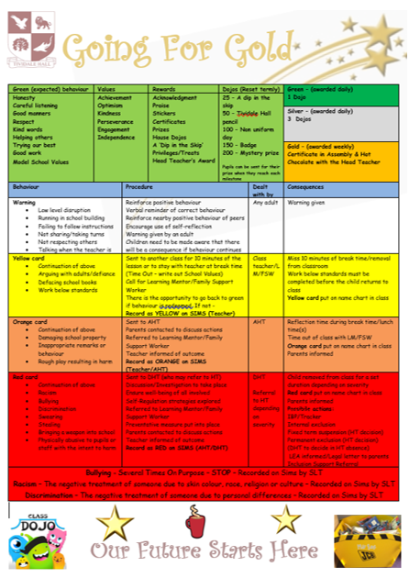

Slide 6

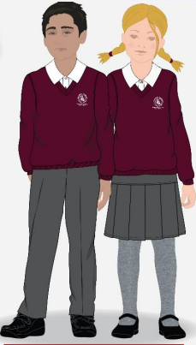
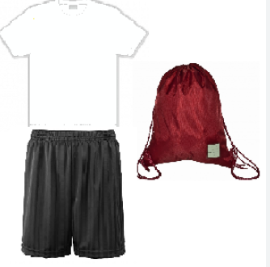

Uniform and PE Kit
Notes:
If children are unable to do PE, please inform staff, write a note

Slide 7

The Curriculum
Overviews on the school website Tividale Hall Primary - Our Curriculum
Themes: Let's settle this! The Shang Dynasty and Road trip to America.
Golden Threads: leadership, communication and community
Subject coverage: Maths, English, Guided Reading, Humanities, Science, French, Computing, Art/DT, RE/PSHE, PE

Slide 8
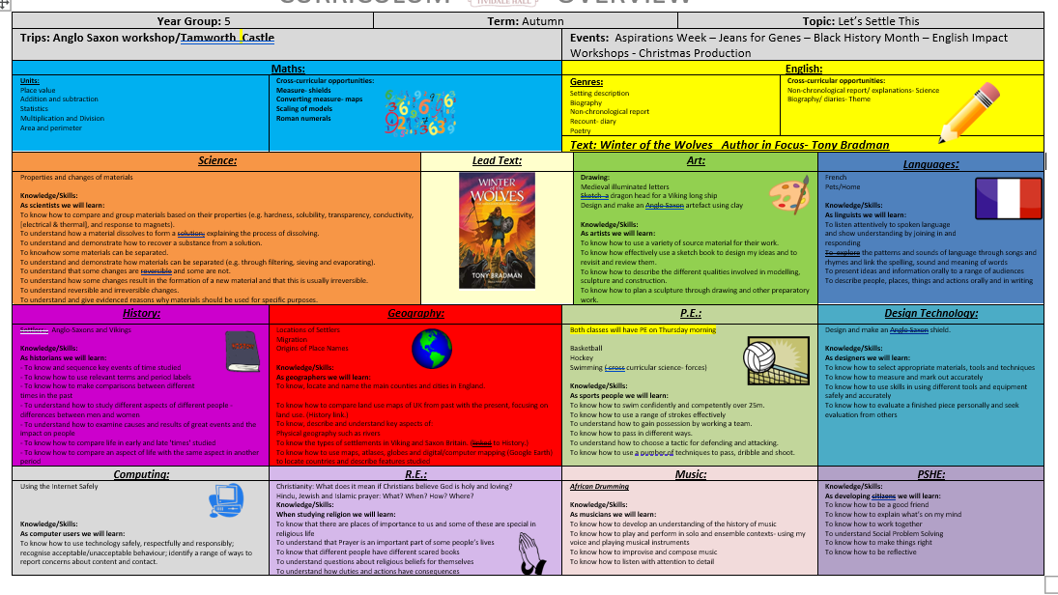

Slide 9
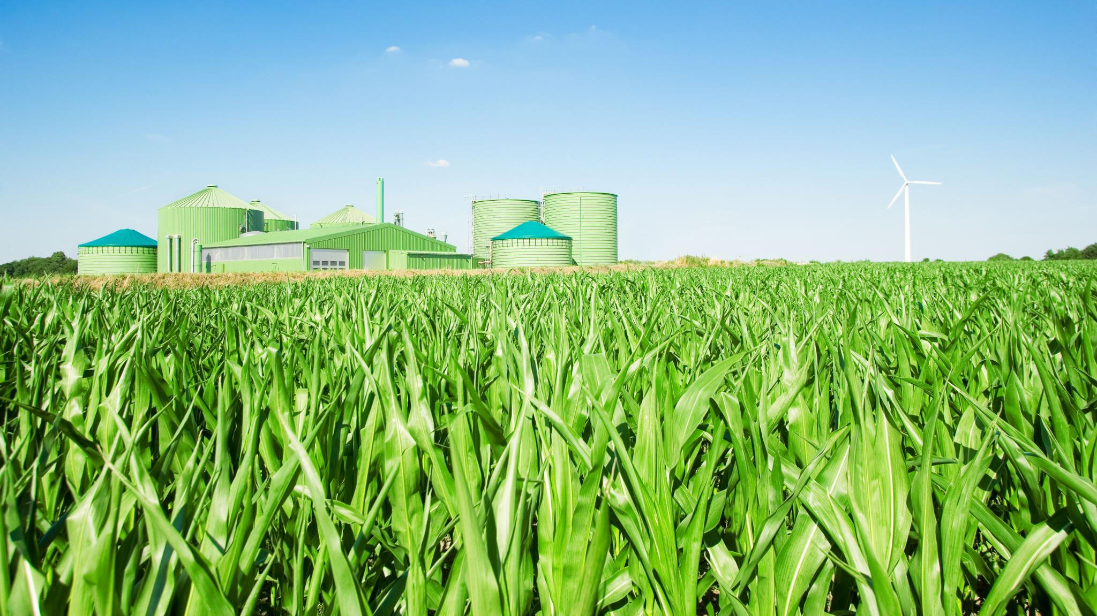
Trips and Experiences
This year:
Tamworth castle
Christmas production
Residential

Slide 10

School Nurse Sessions
PUBERTY TALK
SPRING TERM
The RSE Curriculum

Slide 11
Homework expectations
weekly spellings (tested every Friday)
TT rockstars
retrieval style homework for Maths and English
given out on a Friday and expected the following Friday
weekly reading targets (AR book)
Seesaw

Slide 12

Statutory Assessments
Summative assessments end of summer term
Maths
GPS
Reading

Slide 13
READING EXPECTATIONS
Apply knowledge of root words, prefixes and suffixes to read aloud and to understand the meaning of unfamiliar words.
Read further exception words, noting the unusual correspondences between spelling and sound, and where these occur in the word.
Identify significant ideas , events and characters, and discuss their significance.
Learn poems by heart, for example, narrative verse, haiku.
Use meaning-seeking strategies to explore the meaning of words in context.
Use meaning – seeking strategies to explore the meaning of idiomatic and figurative language.
Identify and comment on writer’s use of language for effect, for example, precisely chosen adjectives, similes and personification.
Identify grammatical features used by writer – rhetorical questions, varied sentence lengths, varied sentence starters, empty words – to impact on the reader.
Draw inferences such as inferring characters’ feelings, thoughts and motives from their actions.
Justify inferences with evidence from the text.
Make predictions from what has been read.
Summarise the main ideas drawn from a text.

Slide 14
MATHS
Numbers to 1,000,000.
Decimals
Fractions (mixed numbers and improper fractions)
Add and subtract fractions
Percentages
Mental maths (using x table facts)
Formal multiplication
Formal division
Angles
Convert between measures
Perimeter and area

Slide 15
Working at the Expected Standard: Grammar and punctuation
I can build cohesion within and across paragraphs using the following:
Co-ordinating conjunctions. e.g., but, or, and, so
Subordinating conjunctions. e.g., although, after, as, when, if, that, even though, because, until, unless, since
Adverbials. e.g., include when and where the verb happened. As the clock struck midnight, the shadow moved across the graveyard.
Pronouns to avoid repetition. e.g., Jon kicked the ball. Jon scored. Jon kicked the ball and he scored.
I can write for a range of purposes.
I can organise my writing into paragraphs.
I can describe settings, characters, and atmosphere. You could use a range of descriptive techniques e.g., expanded noun phrases, similes/metaphors, personification, and onomatopoeia.
I can use a dictionary to check the spelling of uncommon or more ambitious words.
I can use a range of clause structures and vary their position. | Fronted adverbials e.g. Deep in the jungle, a roar erupted.
 | Relative clauses using the relative pronouns who, which and that e.g. Jamie, who was the King’s hand, attacked the intruder.
I can use a range of punctuation mostly correctly: | Full stops and capital letters.
 | Question marks and exclamation marks.
 | Commas in a list.
 | Apostrophes for contractions.
 | Inverted commas.
 | Apostrophes for possession.
 | Commas for clauses.
 | Commas for fronted adverbials.
 | Brackets, dashes, and commas (parenthesis).
 | Commas for clarity.
I can use modal verbs to indicate possibility.
e.g., might, should, will, must, could, would
I can use tenses correctly and consistently.

Slide 16

Communication & Questions

