Slide 1


Transition Meeting for Parents of children going into Year 4 .

Slide 2

Class Teachers
Mr Smythe
(Kingfishers)
Miss Callow
(Woodpeckers)

Slide 3


Support Staff
Mrs Gilbert
Mrs Enebechi
Mrs Abbey

Slide 4

Expectations
Timings (8:45-3:30)
Break time (10:15-10:30)
Lunchtime (12:15-1:00)
Drop off point (Bottom playground)
Collection Point (Bottom playground)
Bags/Pencil cases
Toileting
Stairs
Independence
Behaviour Policy
Notes:
toilets

Slide 5
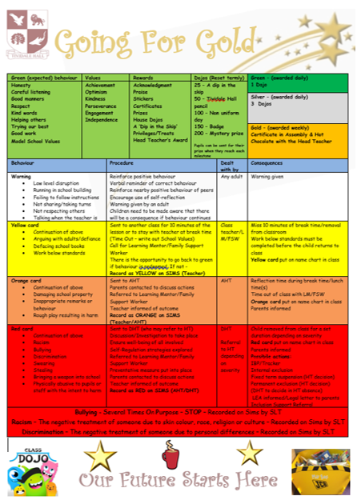


Slide 6

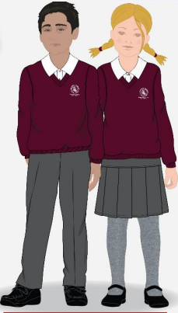
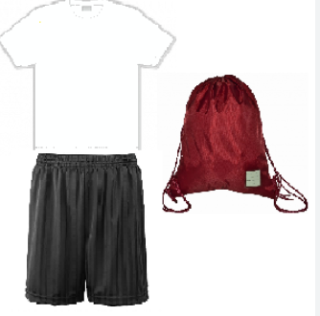

Uniform and PE Kit
Notes:
If children are unable to do PE, please inform staff, write a note

Slide 7

The Curriculum
Overviews on the school website Tividale Hall Primary - Our Curriculum
Themes: The Romans
Golden Threads:Leadership
Subject coverage: Maths, English, Guided Reading, Humanities, Science, French, Computing, Art/DT, RE/PSHE, PE

Slide 8
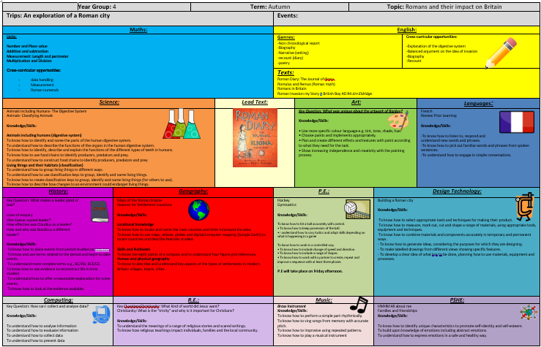

Slide 9
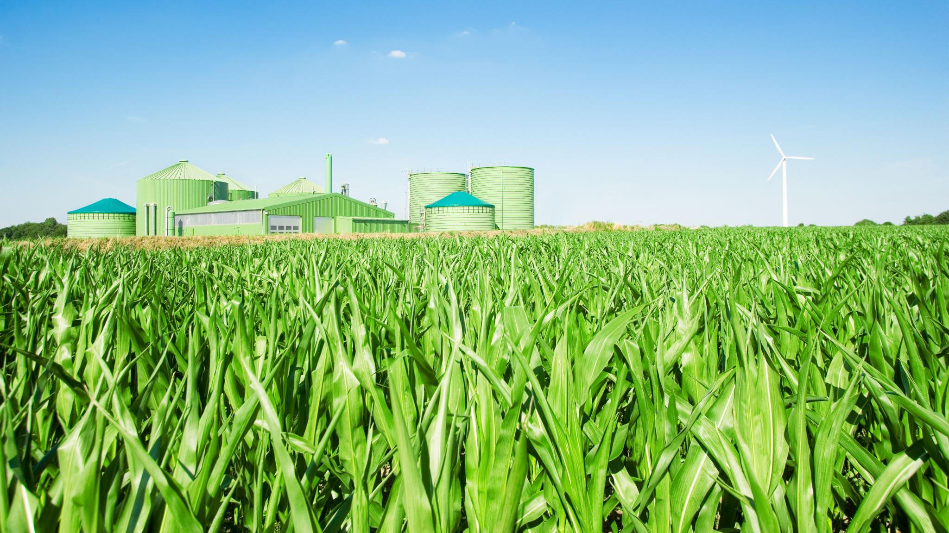
Trips and Experiences
This year:
Wroxeter Roman city
Christmas production
Black Country Museum
Residential

Slide 10

These modules are:
• All About Me
• Friendships
• Resilience and Coping
• Belonging
• Being the Best I Can Be
• My Wider World
The RSE Curriculum

Slide 11
Homework Expectations
WEEKLY SPELLINGS (TESTED EVERY FRIDAY)
TT ROCKSTARS
RETRIEVAL STYLE HOMEWORK FOR MATHS AND ENGLISH
GIVEN OUT ON A FRIDAY AND EXPECTED THE FOLLOWING FRIDAY
WEEKLY READING TARGETS (AR)

Slide 12

Statutory Assessments
Summative assessments end of summer term
Maths
GPS
Reading

Slide 13


Multiplication
Check (MTC)

Slide 14
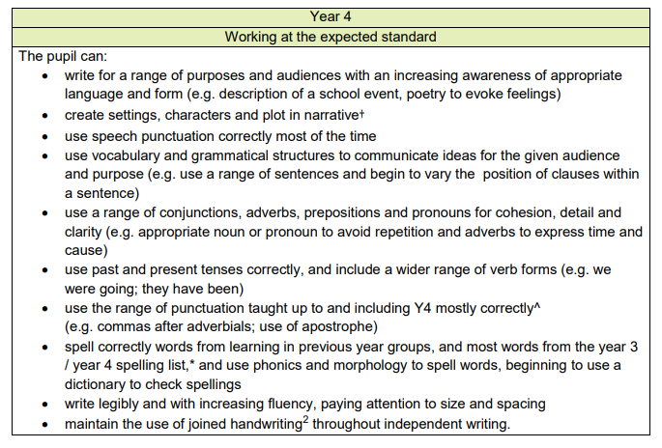

Slide 15
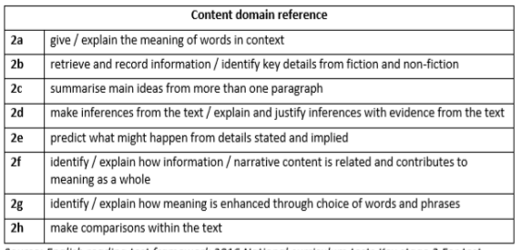

Slide 16
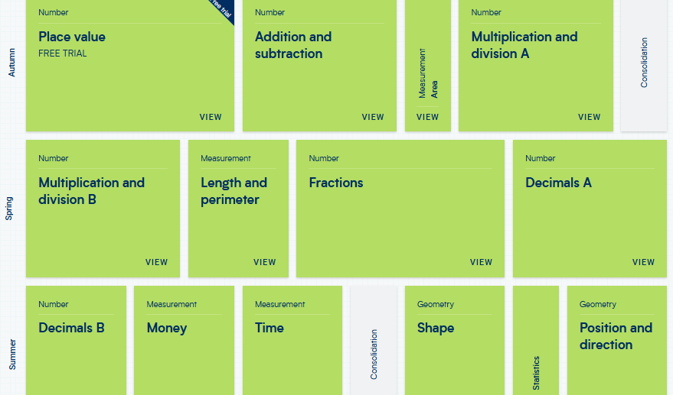

Slide 17

Communication

