Slide 1

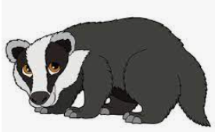
Welcome to the Year 3
Reading Workshop
Wednesday 15th October
Notes:
Good morning everyone, and thank you so much for joining us for our Year 3 Reading Workshop. Today is all about helping you understand how we teach reading in school, and how you can support your child at home. Later, you’ll get to take part in a guided reading activity with your child — so we hope you’re ready to dive into a text together!

Slide 2
Why reading is important in Year 3
Reading helps children grow their vocabulary and understand how language works. When children read regularly, they pick up new words and see how sentences are put together. This supports their speaking and writing skills in a natural way.
Notes:
Reading in Year 3 is a big step forward. Children begin to move from learning to read, to reading to learn. It helps build vocabulary, sentence structure, and confidence in both speaking and writing. The more they read, the more they grow.

Slide 3
Home reading books
At the beginning of the academic year, children complete a ‘Star Reader’ quiz to determine the range of books which are appropriately challenging for them. Those children that are currently supported to read using the Little Wandle phonics scheme, will continue to access phonics-based texts to support their reading fluency and access to the texts at their current stage.
Children are encouraged to select their own book according to what appeals to them, but supported to read a range of fiction, non-fiction and poetry.
Targets are set each Monday. 2 dojos are given when achieved. Book quizzes are taken on completion of each book. 80%+ means that a child can move up a level within their range.
Notes:
We use a system that encourages independence and choice. Children take a Star Reader quiz to find their reading range, and they’re supported to choose books that interest them. Reading records are still important — we ask that you continue listening to your child read and jot down comments. It really helps us track progress and celebrate achievements.

Slide 4
Reading records
Although the children are now in Year 3, it is still encouraged that parents or carers continue to listen to them read. We will also do the same in school and this will support them to continue to develop their fluency and understanding of the books that they are reading.
Children can keep their reading records up to date by:
Listing the books they have read inside the front cover.
Keeping a record when they read including the date, title and number of pages read.
There is a comment box which is intended to be used for adult comments (teachers and parents) along with quiz results (in green) and targets (in red).
Notes:
Although children are now in Year 3, it’s still encouraged that parents continue listening to them read. We also do the same in school. Reading records help us track fluency and understanding. Please use the comment box for feedback when you hear your child read and we will also include quiz results, and targets.

Slide 5
Reading for pleasure
https://literacytrust.org.uk/reading-for-pleasure/
Children who regularly read for pleasure have better self-esteem and emotional regulation, with lower levels of emotional and behaviourial challenges such as anxiety and aggression than those who don't. Children who read have higher levels of mental wellbeing and happiness.
Children have access to the school library where they can sign out a book of the choice along side the book that they are reading at their reading stage.
Notes:
Reading isn’t just about schoolwork — it’s about enjoyment. Children who read for pleasure tend to be happier and more emotionally resilient. We encourage visits to the school library and sharing books at home. Even 10 minutes a day makes a difference.

Slide 6
Skills taught during guided sessions in Year 3
In Year 3, guided reading skills should focus on developing comprehension through retrieval, inference, and prediction, while also teaching summarising, vocabulary analysis, and understanding authorial choices. Children should learn to skim and scan for specific information, use the opening sentences of paragraphs to identify main ideas, and use tools like glossaries and dictionaries to clarify word meanings. Activities should also include making connections between different parts of the text and comparing/contrasting information.
Notes:
In Year 3, we teach children to retrieve information, make inferences, predict, and summarise. We also explore how authors use language and structure. These skills help children become thoughtful, confident readers.

Slide 7
Core comprehension skills Year 3?
Retrieval: Finding specific information and key details from the text.
Inference and deduction: Reading between the lines and drawing conclusions based on the evidence in the text.
Prediction: Maing informed guesses about what will happen next.
Summarising: Identifying and retelling the main points of a text in their own words.
Author’s craft: Discussing the author’s choices, such as word choices and sentence structure.
Comparison: Comparing and contrasting different extracts or characters.
Notes:
These are the core skills we focus on during guided reading. Retrieval, inference, prediction, summarising, author’s craft, and comparison. These help children understand and engage with texts more deeply.

Slide 8
Reading strategies taught in Year 3?
Skimming and scanning: Quickly looking for specific information using features like the contents page, index, and headings.
Using text structure: Using the opening sentence of a paragraph to understand its content.
Annotation: Marking up text to highlight key words, information or phrases.
Contextual clues: Using the surrounding text to infer the meaning of unfamiliar words.
Notes:
We also teach strategies like skimming and scanning, using text structure, annotation, and using contextual clues. These help children become more independent and strategic readers.

Slide 9
What does Guided Reading look like in Year 3?
VIPERS
Monday – Introduction of skill and video and class discussion
Tuesday – Images - stills from the video - children create a written response to the images based on the focused skill.
Wednesday – Text - class discussion and teacher modelling of answering written questions based on the chosen skill. The text must be age appropriate, of good quality and of good length to increase reading stamina. The text being focused on will be in the children’s Guided Reading book to annotate and re-read the following day.
Thursday - Same Text - pupils independently answering written questions that are presented in various SATs style presentations.
Notes:
We use a structure called VIPERS
V – Vocabulary: Understanding the meaning of words in context.
I – Inference: Reading between the lines to understand what is implied but not directly stated.
P – Prediction: Anticipating what might happen next based on clues in the text.
E – Explanation: Explaining why things happen or why the author made certain choices.
R – Retrieval: Finding and recalling specific facts or details from the text.
S – Sequencing: Understanding the order of events in a story or text. — it helps us focus on different reading skills each day.

Slide 10
Wednesday 15th October 2025
Discussion/ text analysis
L.O: To be able to analyse a text and retrieve information from a text
Success Criteria: Have I:
Identified the word in the question I am being asked to define?
Read the word in the sentence that it appears in within the text?
Read before and after the sentence to understand the context?
Made an inference based on what I already know?
Notes:
Before we begin, here’s what to keep in mind during the activity: Let your child lead the reading. Ask questions like ‘What do you think that means?’ or ‘Why do you think that happened?’ Praise their effort and curiosity. You’re modelling how to be a reading partner.

Slide 11
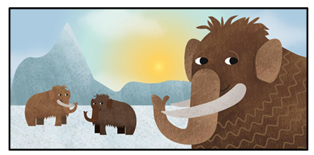
The Woolly Mammoth
Today, there are sadly no woolly mammoths alive because they all became extinct (died out) about 10,000 years ago. However, we do know a lot about them because we still find their bodies! About 10,000 years ago there was an ‘Ice Age’ and the majority of the earth was covered in huge glaciers, snow and ice. When the woolly mammoths died, their bodies were buried in the permafrost which preserved their bodies. So now, when the land around riverbanks erodes or people dig into the earth their bodies are revealed. Amazingly, their bodies are preserved so well they look virtually the same as when they died.
Woolly mammoths are cousins of today’s Asian elephants and lived around 250,000 years ago. They inhabited northern areas in the world such as Canada, Siberia and the Arctic. They looked a lot like our modern-day elephants except that they were covered in thick, brown hair! Sometimes the hair could grow to 1m long and was essential to keep them warm in the freezing cold temperatures. Did you know that they even had fur-lined ears? Woolly mammoths also had long, curved tusks with a point on the end. These tusks were used for fighting and also as a digging tool to forage for plants, roots and grasses buried deep beneath the thick layer of snow.
So why did the woolly mammoths die out? Theories have been suggested including over-hunting by humans and climate change. However, the most likely cause is that a comet struck earth killing many of the species and altering the balance of life on our planet forever.
Notes:
Read the text with the parents and children.
Are there any words as you are reading along that we are not sure of the meaning of? Make note on whiteboards to discuss after reading the text.
We’ll now discuss the text and model how to retrieve information. Parents can support by asking questions and encouraging their child to explain their thinking.

Slide 12
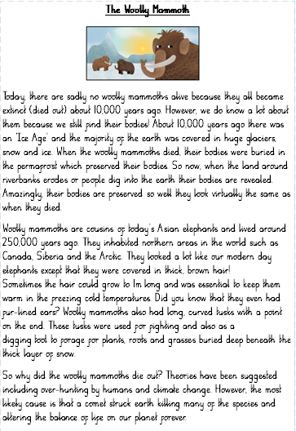
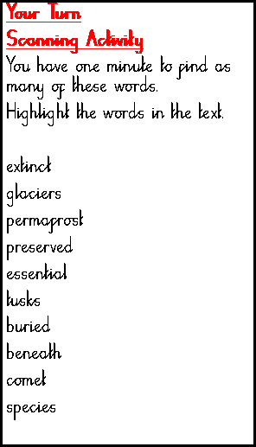
Notes:
This is the text we’ll be reading together. Parents and children should read it aloud and discuss key facts.
Are there any words as you are reading along that we are not sure of the meaning of? Make note on whiteboards to discuss after reading the text.
Complete the one-minute challenge to fins the list of words in the scanning activity.
3-minute challenge to write one or two words to say what these words mean in context e.g., read around the word to clarify its meaning.
Go through each word to clarify meaning as a whole class and also pick up on any other words that children may have been unsure of and clarify their meaning.

Slide 13
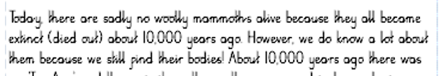
Discussion Questions:
1. How many years ago did Woolly Mammoths become extinct? Circle one answer.
1 year ago 1000 years ago 10,000 years ago
Notes:
Use this slide to pause and reflect. Ask parents what stood out to them in the text and how they might support their child’s understanding.
Ask the question and think about what the key part of the question is and how the children will pick out the key parts before answering
e.g. How many years ago
Extinct
These words will be visible in the text when retrieving the information, so we do not have to remember or guess the answer as it is right in front of us.

Slide 14
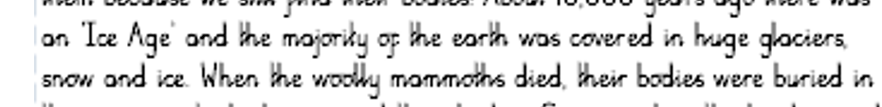
2. Complete the sentence
In the Ice Age, the earth was covered in...
__________________________________________
Notes:
This is a retrieval question. Encourage children to find the answer in the text and explain how they know it’s correct. Use fastest finger first to get a visual AFL of where the children can see the answer in the text.

Slide 15
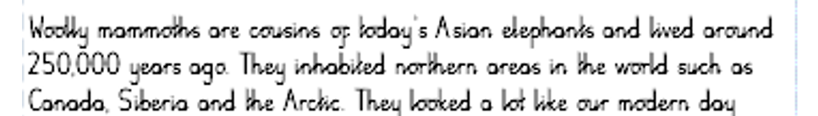
3. Who are Woolly Mammoth’s cousins?
________________
Notes:
This question helps children recall specific details. Parents can guide them to reread the relevant part of the text. Model finding the key word in the question that will also be present in the text to find the exact answer.

Slide 16
4. How long did Woolly Mammoths hair grow? Tick one.
5 meters long
10 meters long
15 meters long

Slide 17
5. True or False?
Statement | True | False
Woolly Mammoths are extinct
Woolly Mammoths were found in the Arctic.
Wolly Mammoths had small, curved tusks
Woolly Mammoths were hunted by humans.
Notes:
This question focuses on vocabulary. Encourage children to find the detail about hair length and discuss why it was important.

Slide 18
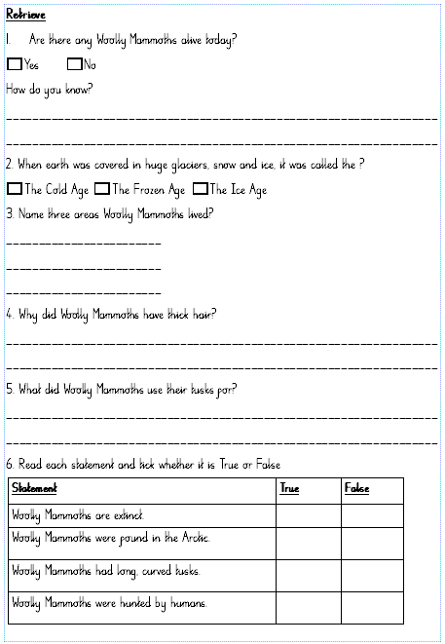
Notes:
This true or false question helps children practice retrieval and reasoning. Ask them to justify their answer using the text.

Slide 19
Thank You for coming to our Reading Workshop.
Notes:
Use this slide to wrap up the activity. Ask parents to reflect on what their child did well and what they might work on together.

