Slide 1




Transition Meeting for Parents of children going into Badgers and Foxes in Year 3.

Slide 2



Class Teachers
Miss Johal
Mrs Wycherley

Slide 3

Support Staff
Mrs Chandler
Miss Minks

Slide 4

Expectations
Timings
Break – 10:15-10:30
Lunch – 12:15-1:00
Drop off point: Bottom Playground
Collection Point: Bottom Playground
Bags: Small Bags
Toileting
Stairs
Behaviour Policy
Independence

Slide 5
Children only need a book bag or a medium bag that can contain an A4 sized book and fit on to the peg or cupboard.
Labelled water bottle which as a healthy school we prefer to be filled with water and a healthy snack.
PLEASE label all of your child’s uniform, bags and PE kit.

Slide 6

Break times
Children will have a morning break as well as lunch time. They will no longer have an afternoon break.
Send your child to school with one small, healthy snack for morning playtime. As a reminder this snack should not contain any nuts as we have children with allergies.

Slide 7

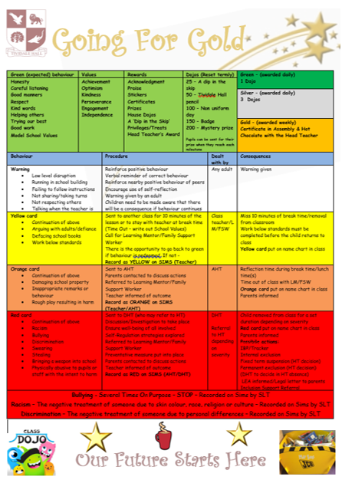

Slide 8

Dojos
These are points the children earn for making good choices with their work and behaviour.
25 dojos they receive a ‘dip in the skip’.
50 dojos, a school pencil.
100 dojos, the children can wear their own clothes for a day, we will send a note home to let you know.
150 dojos, a badge
200 dojos, secret prize

Slide 9
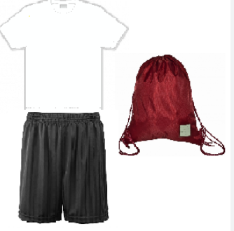
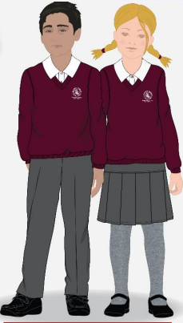


Uniform and PE Kit
We will let you know PE days once timetables are sorted.
We will keep PE kits in school and send home at half term for washing.
Ensure hair is tied back and earrings are removed.
All children should now be confident in getting changed themselves, but some support can be provided when necessary. Children will be spilt into gender groups to get changed between the two classes. PLEASE label everything.
•

Slide 10

The Curriculum
Overviews on the school website Tividale Hall Primary - Our Curriculum
Themes: Stone age
Golden Threads: Leadership through Humanities
Subject coverage

Slide 11
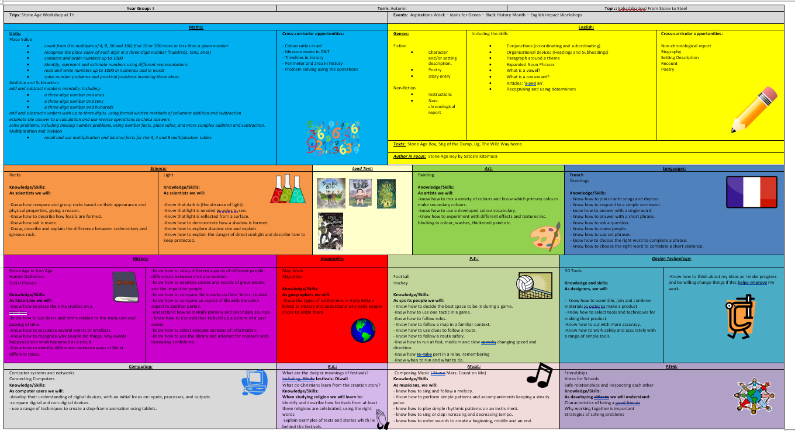
Autumn Overview on school website
Tividale Hall Primary - Our Curriculum

Slide 12




English
Author in Focus: Stone Age Boy by Satoshi Kitamura
Fiction: looking at character and/or setting description, poetry and diary entries.
Non - Fiction: creating instructions and writing non-chronological reports.
GPS focus: conjunctions (coordinating and subordinating), organisational devices including headings and subheadings, writing paragraphs around a theme, expanded noun phrases, identifying vowels and consonants, articles ‘a’ and ‘an’ and recognising and using determiners.
We will read other texts as class reads around the same or similar genre and children may wish to read them themselves as reading for pleasure. We will regularly recommend reads and would love recommendations back for children to share with their peers.

Slide 13
Maths
Place Value 0 - 1000
Addition and Subtraction 0 - 1000
Multiplication and Division A 2, 5, 10, 3, 4, 8

Slide 14
Geography - Know the types of settlements in Early Britain linked to History and understand why early people chose to settle there. Carry out map work and look at migration.
History - Learn how to place the time studied on a timeline, using dates and terms related to the study unit and passing of time.
Art - Focus painting techniques, developing mixing skills and knowing which primary colours make secondary colour whilst developing our colour vocabulary,
Science - Looking at rocks and developing knowledge and skills in comparing and grouping rocks based on appearance, physical properties. With the unit on light, we will investigate what light is, why light is important, and what it does.
Music – We will be learning how to compose music using a well-known artist and music the children will recognise.
RE – Will focus on a key question: What are the deeper meanings of festivals?
PSHE – Will focus on friendships, safe relationships and respecting each other.
Computing – learning about computer systems and networks, and connecting computers.

Slide 15

School Nurse Sessions
Healthy Eating
The RSE Curriculum

Slide 16
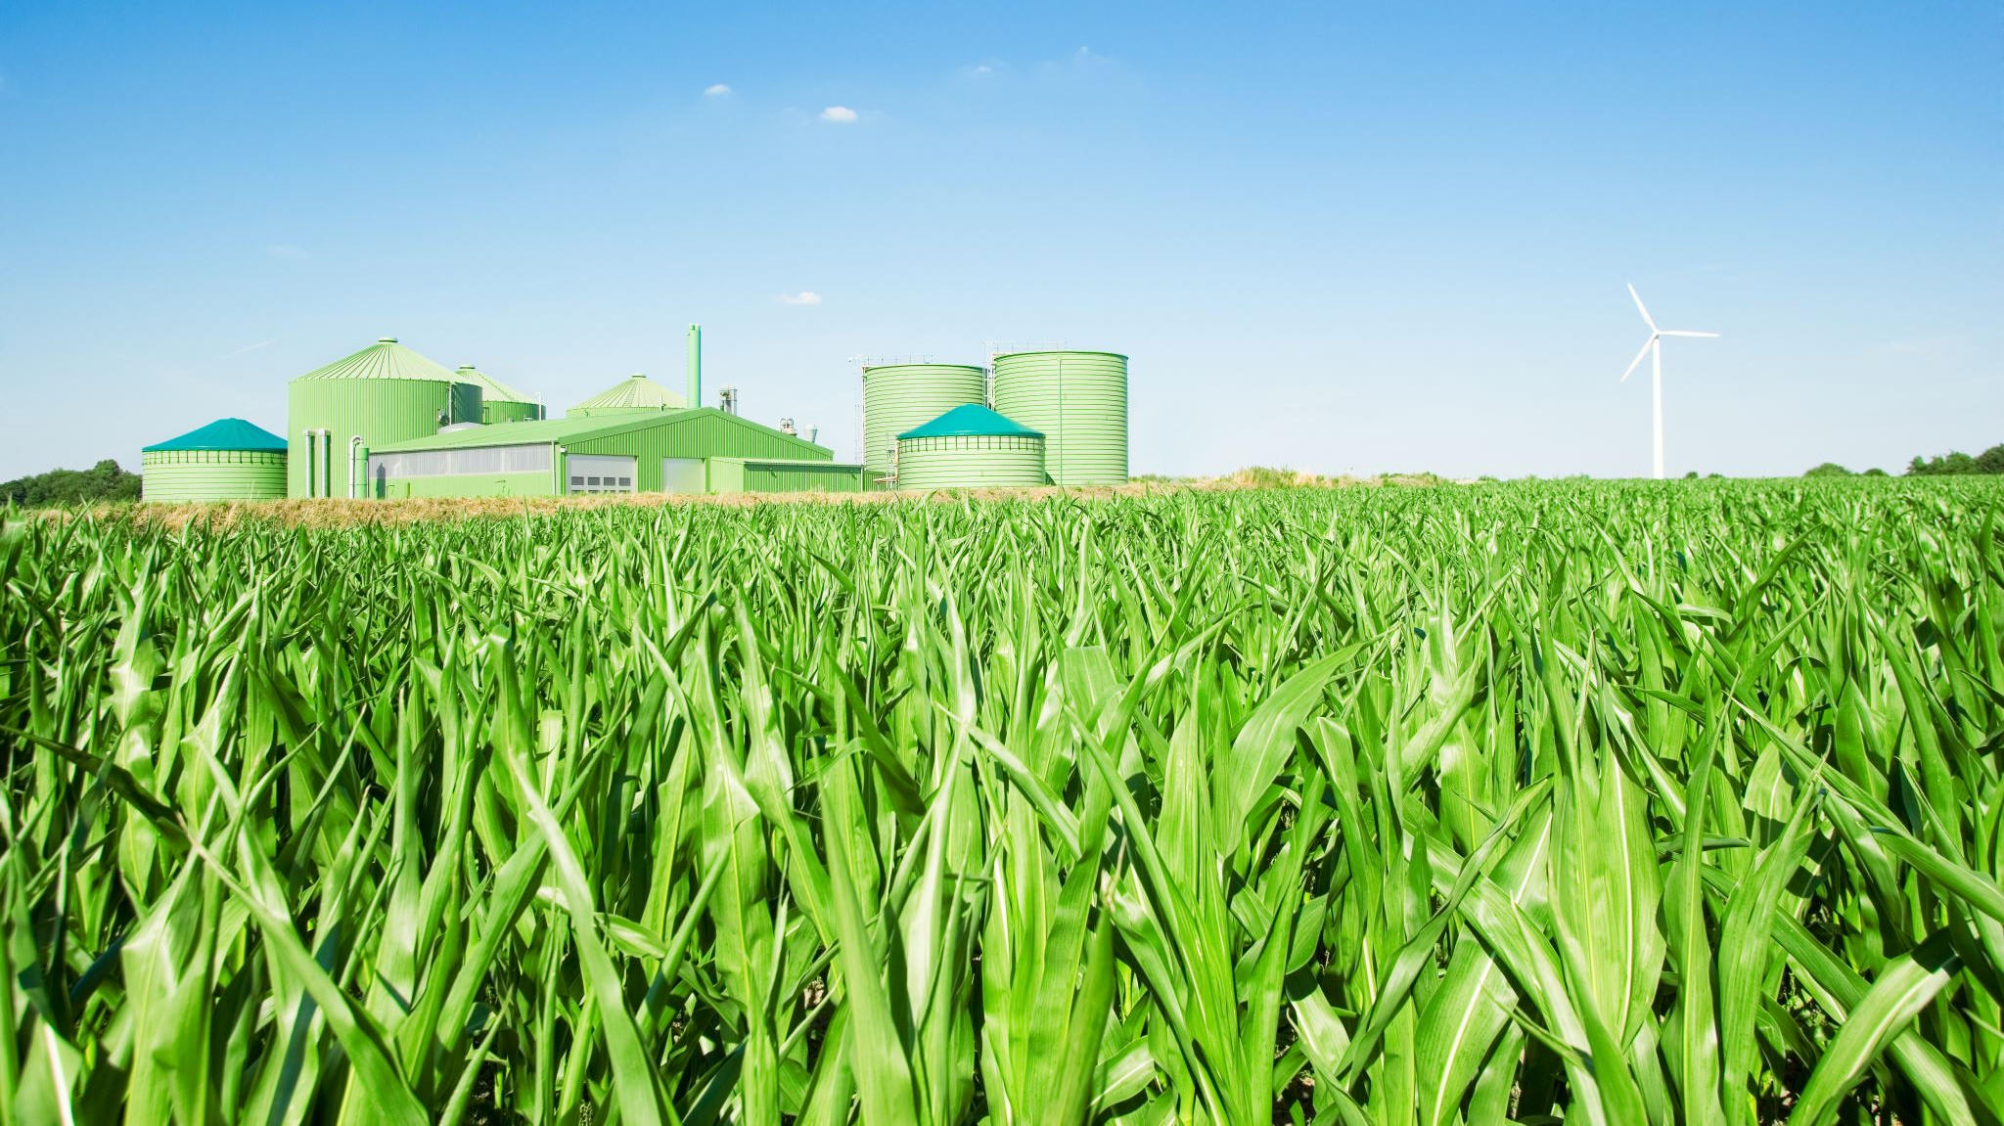
Trips and Experiences
Stone Age Day (Autumn 2)
Edgemond Hall (Summer 1)
Sikh Gurdwara (Summer 2)
Making Greek pottery (Summer 2)

Slide 17

Homework
Weekly
Maths and English.
Spellings.
Reading.

Slide 18

Statutory Assessments
Termly Assessments
(Summer Term)
End of unit assessments

Slide 19

Communication
Seesaw (Homework and notices)
Parents Evenings
Communication through the office.

