Slide 1
Year 2
Reading Workshop
Tuesday 14th October

Slide 2
Reading in Year 2
Phonics sessions
Guided Reading sessions
VIPERS
Home reading

Slide 3
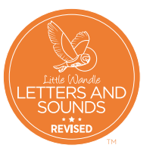
Phonics
Little Wandle – We continue the learning and lesson format from Reception and Year 1.
We assess every half term. We can then organise intervention groups for those that need extra support.
Phonic Screening Check – Children who did not pass the Phonics Screening check in Yr1 will retake in June next year.
Weekly spellings are linked to the phonics taught that week.

Slide 4
Terminology
Phoneme – The sound that a letter makes
Grapheme – The way a sound is written
Digraph – Two letters that make one sound ‘ch’ ‘th’
Split Digraph - eg. Cake
Trigraph – Three letters that make one sound eg. ‘igh’
Segmenting and Blending – eg. c-a-t
Chunking – breaking up a word into manageable chunks eg. cartoon car / toon
Sweeping – Moving your finger under the word to encourage children to read fluently

Slide 5
Reading – 2 times a week
Children read in groups of no more than 6. Each group that is reading has an adult working with them.
We look at key sounds and key words in the book. We discuss what the focus of the book is and if it is fiction or non-fiction. They read through the book at their own pace whilst the adult listens in, picking up any errors and supporting. We focus on comprehension and inference style questioning to get an insight into your child’s understanding of what they have read.
When your child has read their book to an adult, they will complete a related activity such as a book review or play a phonics game / complete a phonics activity based on the phonics content of the book.

Slide 6
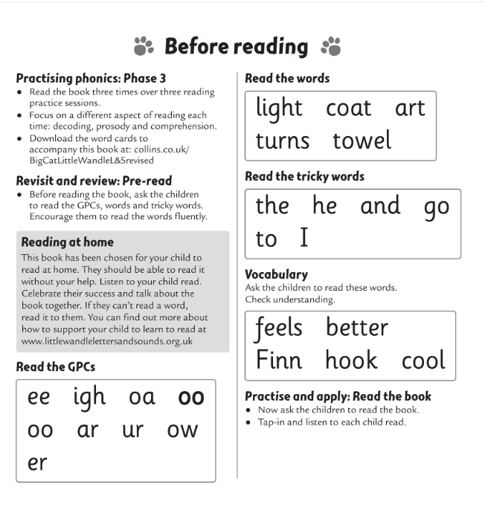
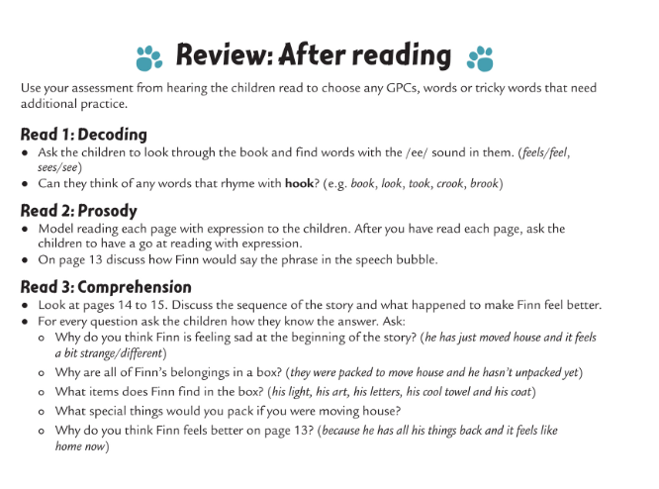
At the start of the book there is information linked to the main phonic content. There is also advice on how to approach the reading with your child.
At the end of the book there are example questions for you to ask.

Slide 7
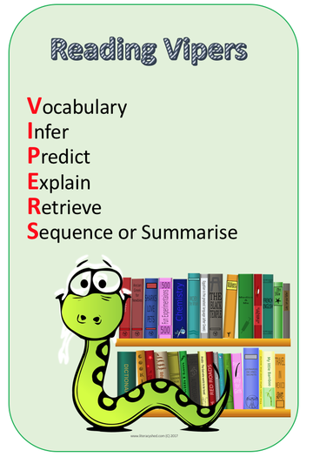
Once children complete the Little Wandle phonics scheme they will begin VIPERS reading sessions. This is where they focus on the key areas of reading comprehension.
Vocabulary – the meaning of words
Inference – use what you already know to explain what is happening
‘I think ....... because....’
Predict – what do you think will happen?
Explain – explain your reasons for your answers
Retrieve – locate an answer directly from the text
Sequence – order events from the text

Slide 8

Tuesday 14th October
Retrieving from a video.
L.O: To know how to clearly explain my understanding of what I have watched.
 | Success Criteria – Have I:
Watched the film and understood what has happened?
Read the retrieval questions?
Used evidence from the film to answer the questions?

Slide 9

What might this video be about?
https://www.literacyshed.com/bubbles.html

Slide 10
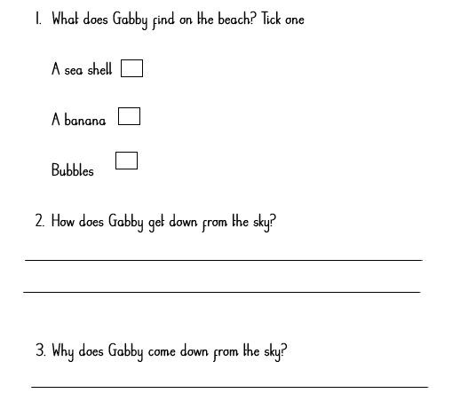

Slide 11
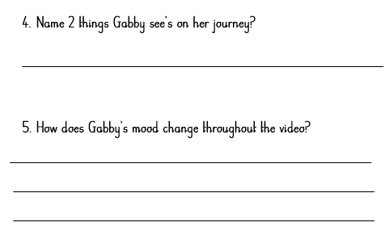

Slide 12
Reading At Home
A reading book is sent home every Friday. This needs to be returned by the following Wednesday.
New reading books will not be sent home if the previous one has not been returned.
If a book is lost or damaged there will be a £5 fine.
In the reading diaries, we put a target based on fluency, expression or comprehension. Please sign the diaries to show you have read with your child and write any comments you have.
Reading books are in the process of being available online for you to read with your child (as in Year 1).

Slide 13
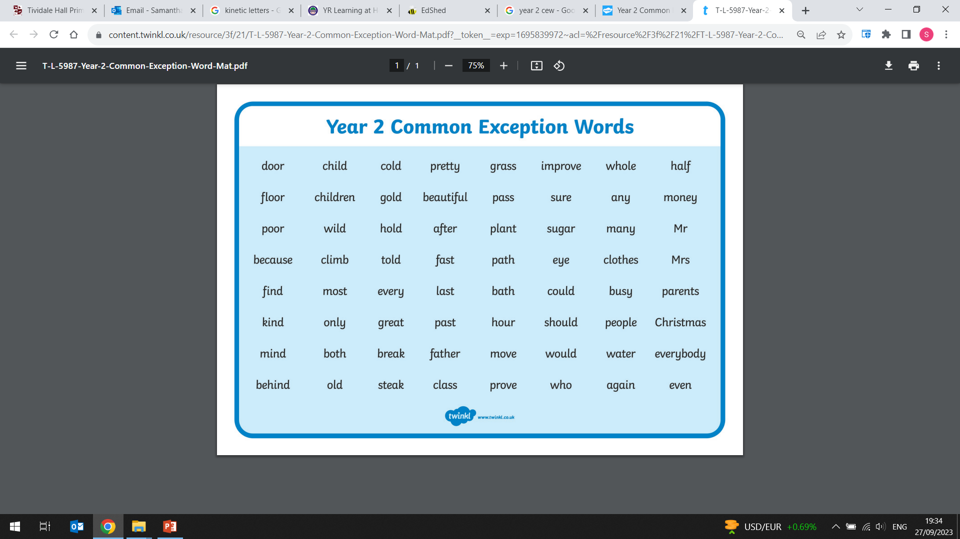
Sometimes your child’s phonics knowledge won't always help them to sound out and read all words. Some of these are on the common exception word list such as "sugar", "improve", "climb" and "because".
We include these in the weekly spellings to ensure your child is exposed to them.

Slide 14
Your Turn
You now have the opportunity to try some different reading activities with your child.
A VIPERS lesson focusing on retrieval.
Common exception word search
Inference pictures and questions

Slide 15
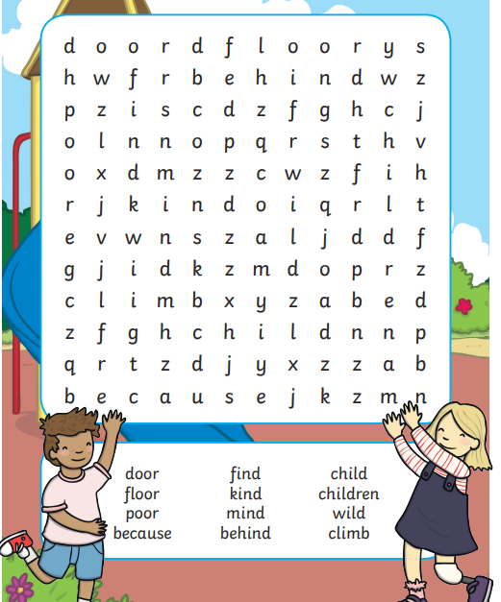
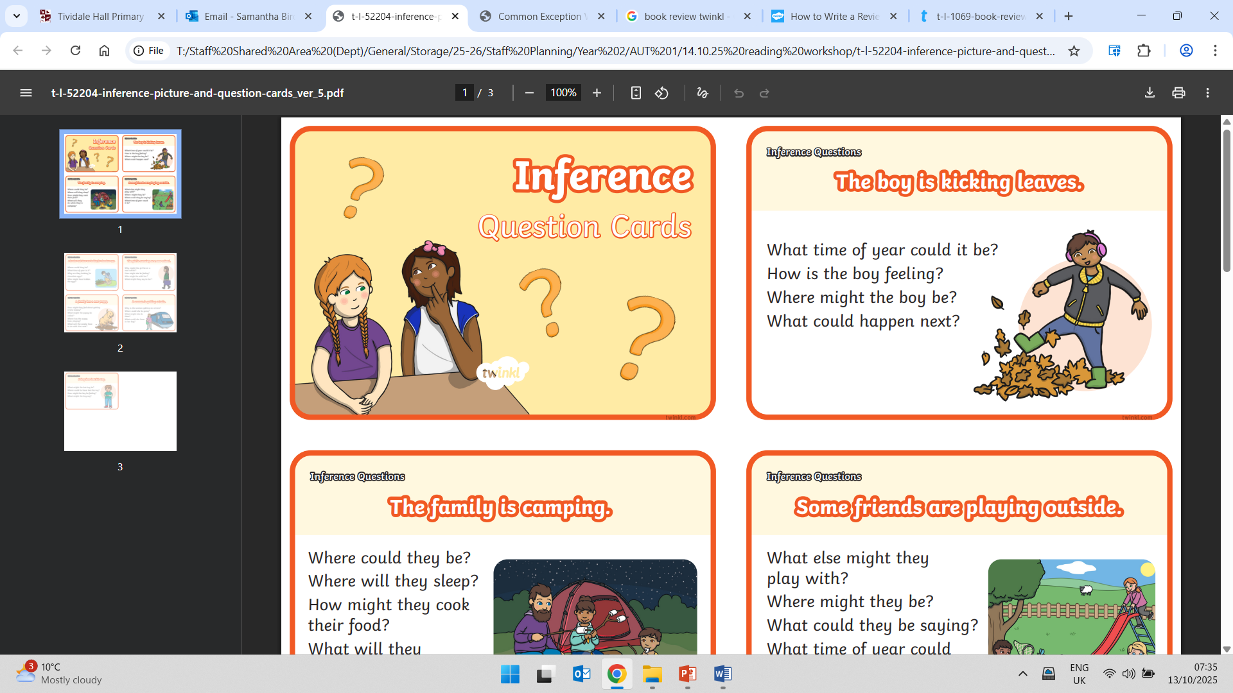
Word search
Inference questions

